Slide 1

Problem Statement:- Predicting The Car Price analyzing the significant variable so that Chinese Firm can bring their business to India.
A Chinese Car making company aspires to enter the Indian market by setting up their manufacturing unit there and producing cars locally to give competition to their Indian and other counterparts.
They have contracted an automobile consulting company to understand the factors on which the pricing of cars depends. Specifically, they want to understand the factors affecting the pricing of cars in the Indian market, since those may be very different from the Chinese market.
The company wants to know:
a. Which variables are significant in predicting the price of a car.
b. How well those variables describe the price of a car.
Based on various market surveys, the consulting firm has gathered a large dataset of different types of cars across the Indian market.

Slide 2
Business Goal
We are required to model the price of cars with the given independent variables in the dataset. It will be used by the company to understand how exactly the prices vary with the independent variables. They can accordingly manipulate the design of the cars, the business strategy and rest to meet certain price levels. Further, the model will be a good way for management to understand the pricing dynamics of a new market.

Slide 3
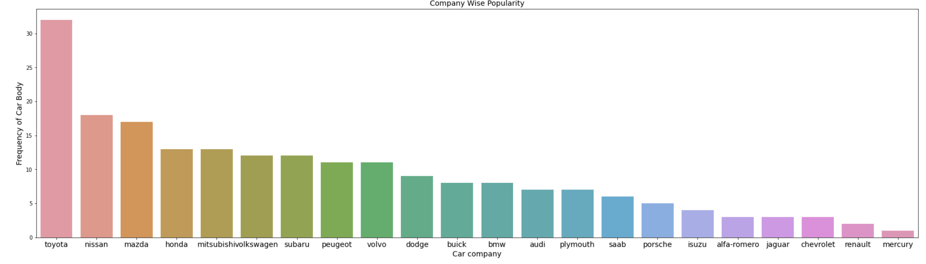
Analysis shows toyota most popular and mercury least popular

Slide 4
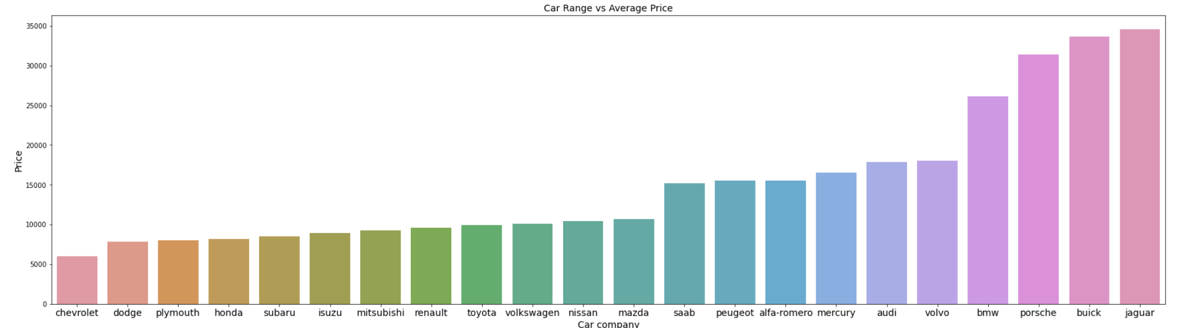
Insights from the plot:
a. Chevrolet has the cheapest average price amongst all companies. b. Jaguar has the highest average price. c. price seems to be dependent on the company name and this shows that we can use this variable in our model because it shows correlation with car price.

Slide 5
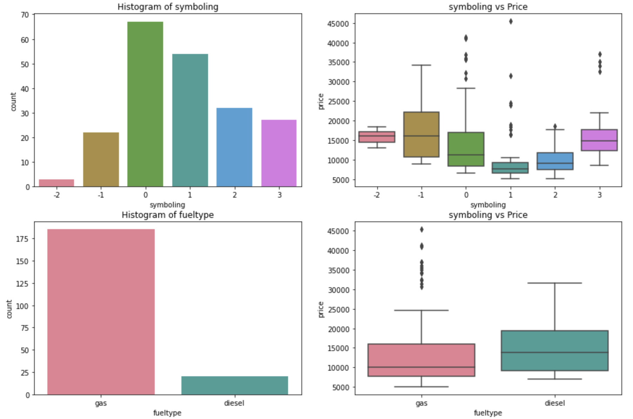
Insights from the plot:
a. Most common value for symboling is 0 and 1. The box plot shows us that symboing 1 has the least median price, followed by 0 and 2. symboling values of -1 and -2 have highest median car price. Symboling could be a good predictor variables because we can see a relation in the value of symboling and the price of car. b. More number of cars have fuel type Gas than diesel. c. Diesel cars have higher median price than gas, although we can see some outliers in the gas boxplot.

Slide 6
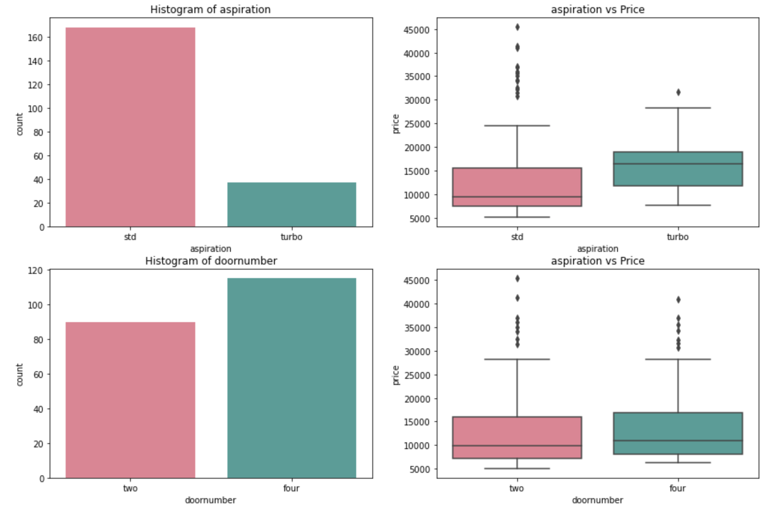
Insights from the plot:
a. cars with turbo has greater median price . And most of the cars has std aspiration. b. door number has no correlation with the car price

Slide 7
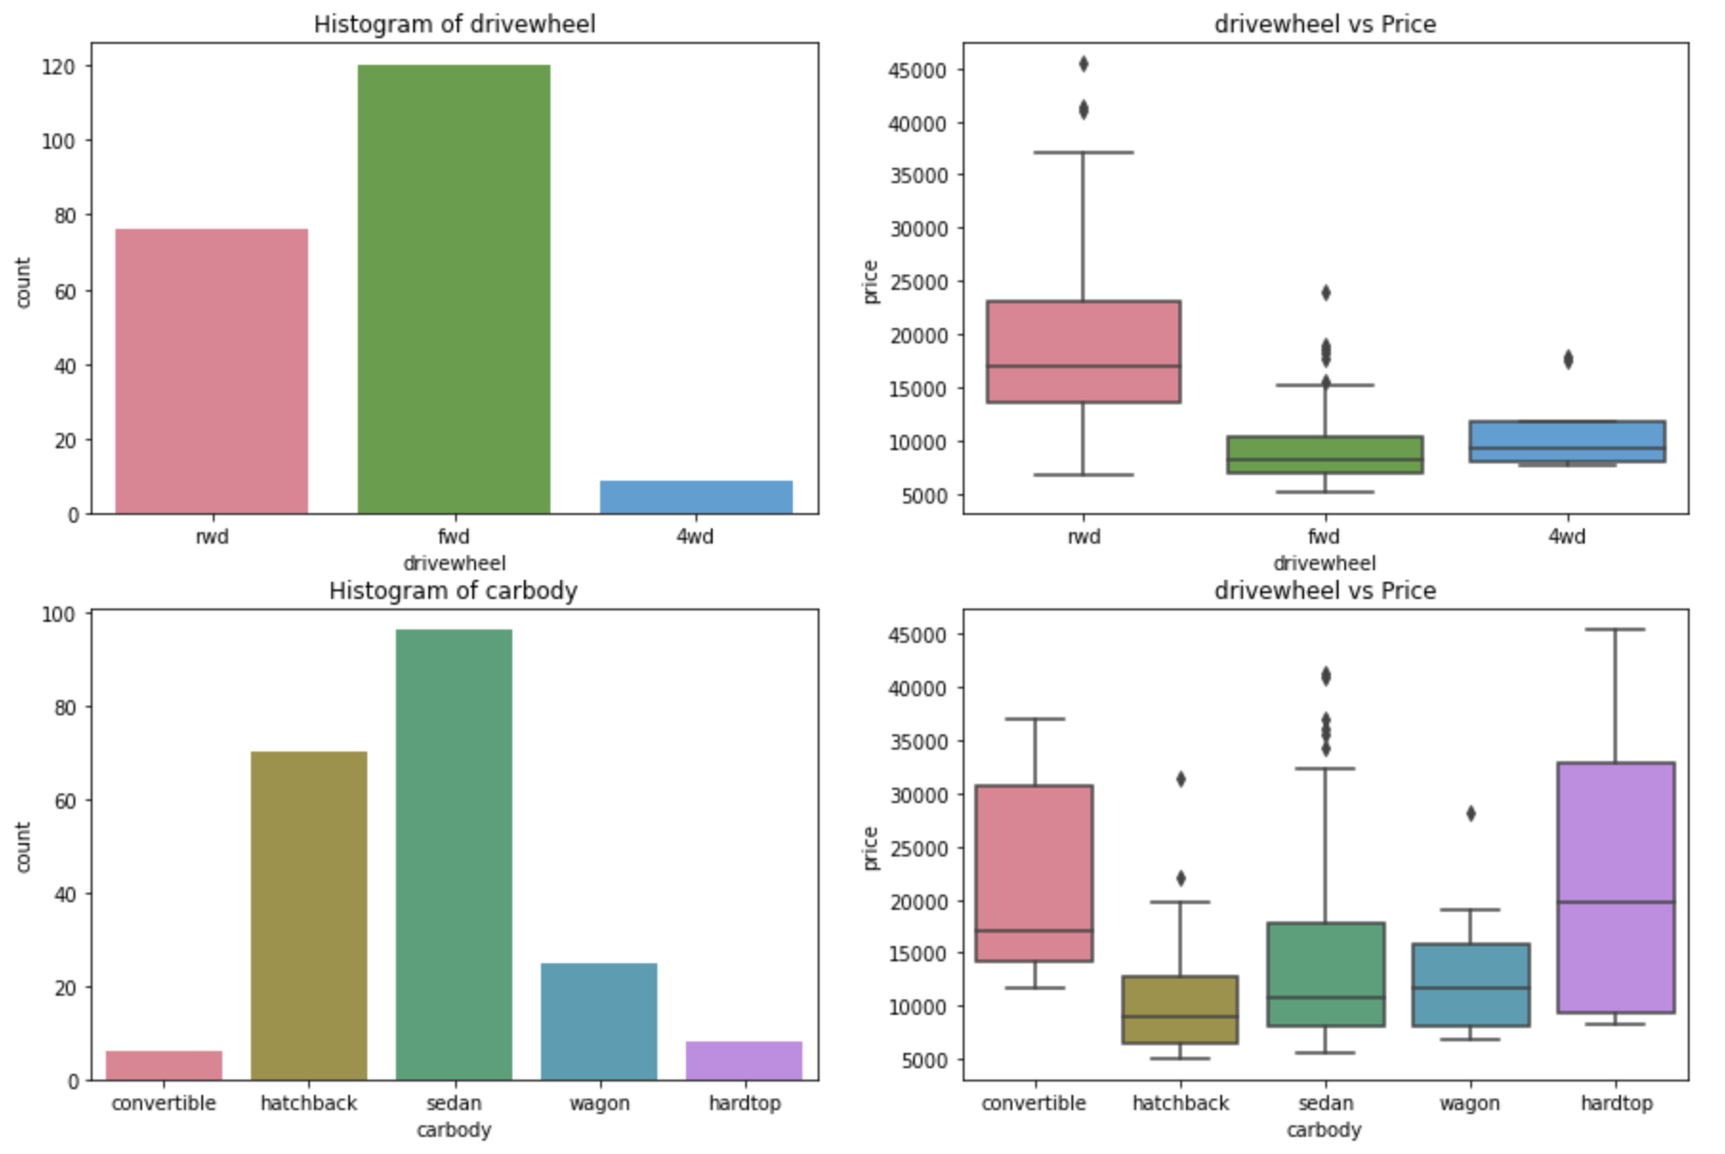
a. most cars are with fwd(forward wheel drive ), 2nd most is the rwd(reverse wheel drive) and the least is the 4wd(4 wheel drive) b. Sedan carbody is the most popular followed by hachback. c. Car type Convertible and Hardtop has the maximum median price.

Slide 8
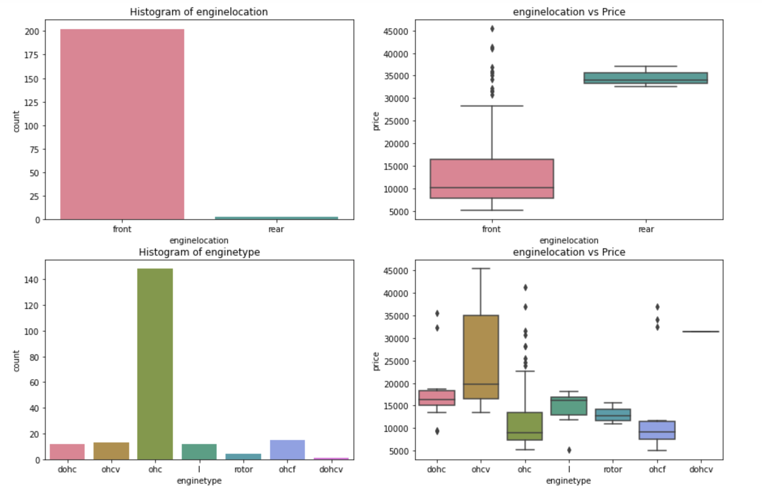
a. enginelocation front has the most popularity and higher median price b. enginetype ohc has the maximum popularity followed by ohcf. c. ofcv enginetype has the maximum median price.

Slide 9
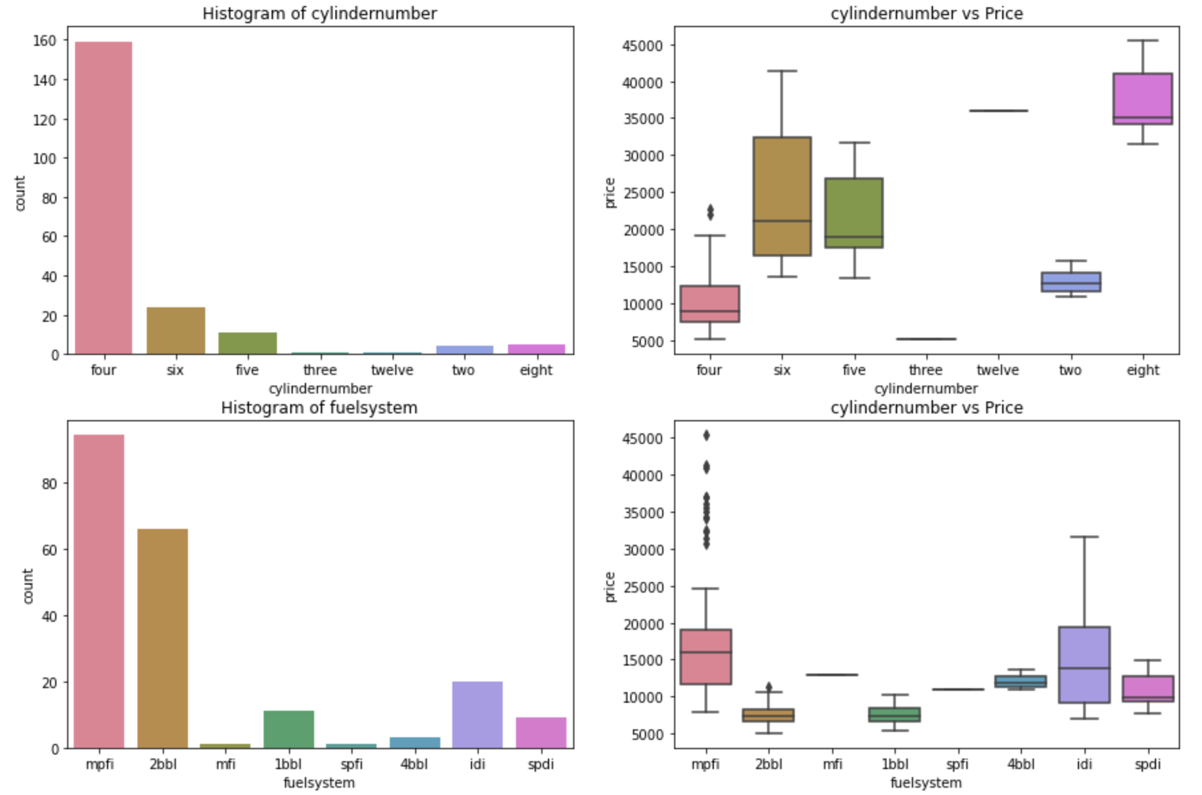
a. four cylinders is the most common number, followed by six. Cars with four cylinder have the 2nd lowest median value after 3 (very few entries again). b. mpfi is the most occuring fuel system. It has the highest median value and also contains outliers which is seen in the boxplot

Slide 10
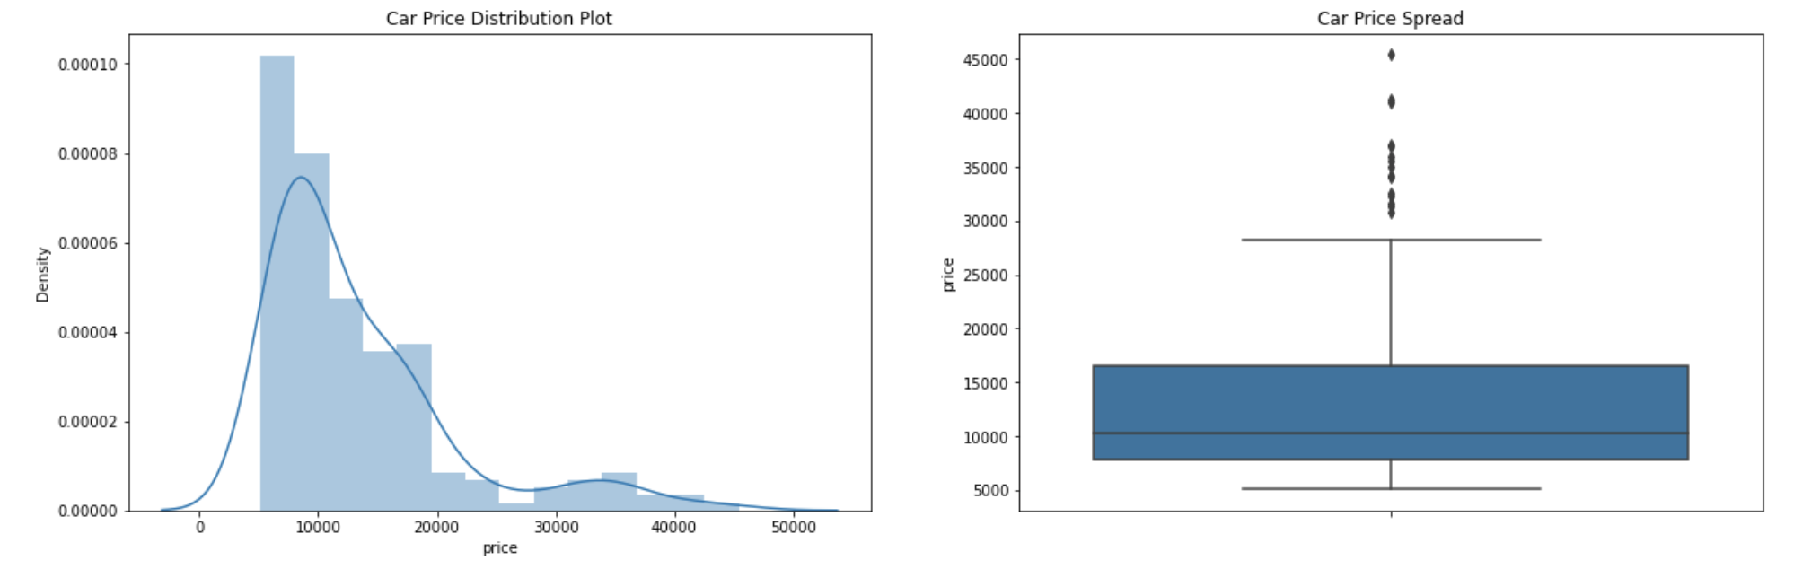
a. The plot is right-skewed, maximum cars price are below (15k) b. There is a significant difference between the mean and the median of the price distribution. c. There is a high variance in the car prices, data points are far from the mean.

Slide 11
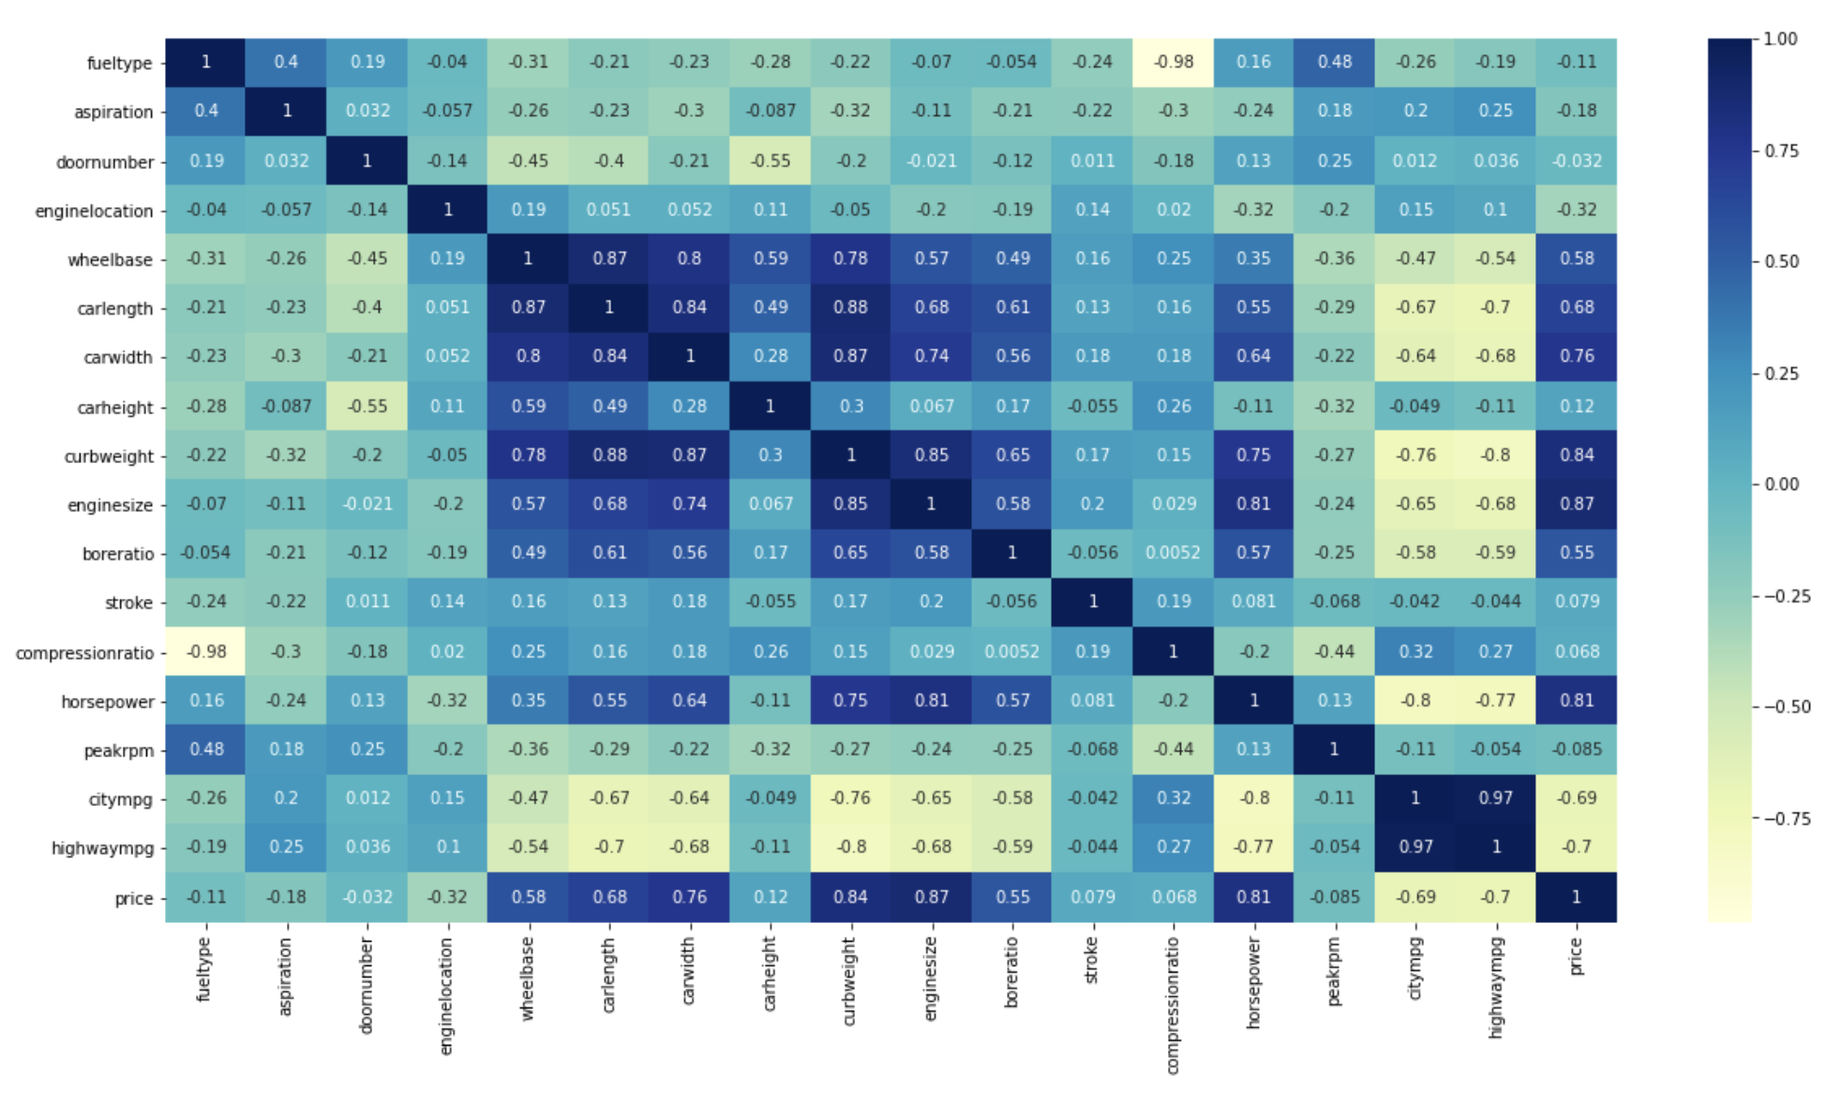
Heatmap reflects the correlation between variables. Based on the correlation we have dropped the columns which has multi collinearity

Slide 12
Now it is the time for the data to be split between train and test
Model building on the train dataset followed by the dropping of the unwanted variables which has high p value and high VIF which proves to have the lowest significance on the price. Looking at the summary when we see that adj R-squared value is decreasing we stop dropping the columns , it means we have removed all unwanted columns. R-squared value near to 1 is considered to be good.
Now we have got our model and now the Y value can be predicted using the x_train data

Slide 13
Same model on the test data we find the results below. This proves that model is performing better.
R2_squared for test is 0.87 and for train is 0.90 which is considered to be high .also train test values are not very far away hence this model can be considered as to be a performing model
Rmse for test is 0.08 and train is 0.06 which is considered to be very less. It reflects that there are less errors in the model. Also values in test and train are not very far away.

Slide 14
Analysis can be provided to the company and the variables which can effect the car price can be considered and actions can be taken by the company to establish their business in the Indian Market.

Slide 15
Thanking You

